Slide 1
Confidence Interval for p
Reasonable Range of Values for True Population Proportion p

Slide 2
Confidence Interval for p
The goal is to take a sample and be able to make intelligent guesses about the true value of the proportion p in the population.
A valuable tool is the confidence interval: the range of values for p in the population that could reasonably have produced the sample p-hat we observed.

Slide 3
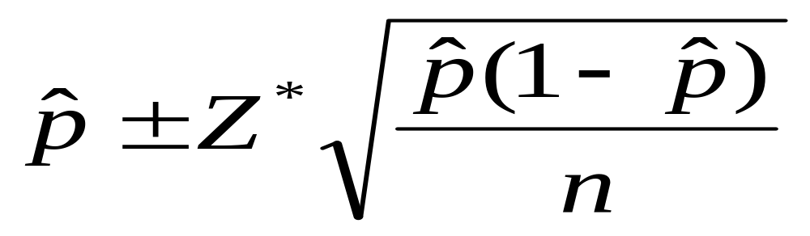
CI Formula
A confidence interval for the population p is given by:

Slide 4
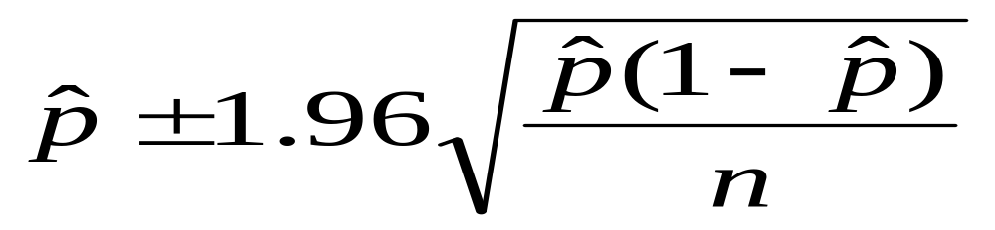
CI Formula
A 95 percent confidence interval for the population p is given by:

Slide 5
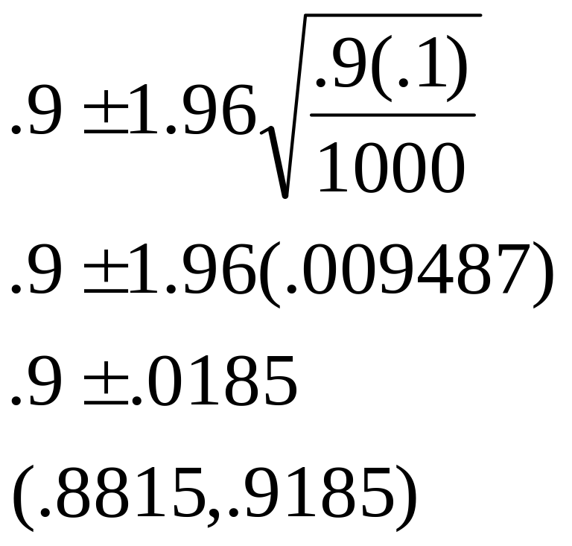
Example
Suppose we cure p-hat = .9 of n=1000 heartworm infected dogs. What is the reasonable range for the cure rate p of our new treatment? Do 95% CI for p.

Slide 6
Example
Reasonable range for p (.88, .92) is same range argued in previous section on sampling distributions for p-hat.
The only reasonable values for p are those that could produce p-hats only a couple of standard deviations removed from the truth.

Slide 7
Reeses Pieces Example
What is the proportion of orange candies, p?
To study this unknown, but very important value p, we will construct confidence intervals for p from samples of candies.
Each bag represents a random sample of size n from the population of these candies.
From each bag your group should: find n, p-hat, and 95% confidence bounds for p.

Slide 8
Reeses Pieces Example
On whiteboard place your information in tabular form:
Group | N | P-hat | CI
1
2
3
4
5
6

Slide 9
Reeses Pieces Example
A histogram of p-hat values should result in a representation of the sampling distribution of p-hat.
The center of this histogram should be p. What do you think p is?

Slide 10
Reeses Pieces Example
From the CI’s, what do you think the true p is?
Is an evenly distributed color distribution p=1/3, a reasonable hypothesis based on our data? Why or why not?
Pay attention to the written conclusion I provide on the board !

Slide 11
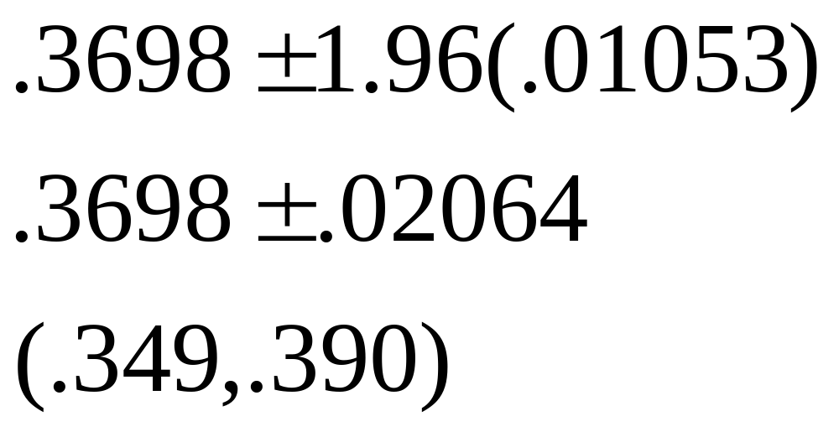
Vietnam Veterans Divorce Rate
N=2101 veterans interviewed found p-hat=777/2101 = .3698 had been divorced at least once.
What is reasonable range of values for true divorce proportion p?

Slide 12
Vietnam Vets Divorces
Do you think true divorce proportion is greater than .5?
Ans: No. The reasonable range of values for the true p is (.349, .390). This range is entirely below p=.5, so we have strong evidence that the true divorce proportion is BELOW .5 not above it.

Slide 13
Vietnam Vets Divorces
Do you think the true divorce proportion could be .37?
Ans: Yes, a proportion like .37 is a reasonable value for the true p according to our range of reasonable values, so the truth could reasonably be .37.

Slide 14
Domestic Violence
For those women who had experienced some abuse before age 18, the sample proportion that had experienced some abuse in the past 12 months was p-hat = 236/569 = .4147
CI for p: (.374, .455).
Suppose the true proportion currently abused for those not abuse before age 18 was .11.
Is there evidence the true population proportion in our study is greater than .11? Why?

Slide 15
Ask Marilyn – Let’s Make a Deal
In 1991 a reader wrote to Marilyn Vos Savant (highest documented IQ) and asked whether a player should switch doors when playing Let’s Make a Deal.
There are 3 doors, two with goats and one with a car. You pick a door. The host, Monty Hall shows you a door you have not picked and there is a goat behind it. You are then asked if you wish to switch doors. Should you switch?

Slide 16
Let’s Make a Deal
Marilyn said yes, you should switch doors.
There was a storm of angry letters from bad colleges with bad statistics professors.
“you are the goat”, “take my intro class”, “it is clearly 50-50 with no advantage to switching”.
The next week stats professors from elite universities like Harvard, Stanford, UMM wrote in and said that Marilyn was correct, but her reasoning was wrong.

Slide 17
Let’s Make a Deal
Let’s play the game on the computer simulation, be sure to play the strategy of switching doors after a goat is shown to you. Keep track of how many times you win divided by the number of plays. Compute p-hat.
Who is right? Marilyn or the bad professors?
Do a 95% CI for p, the proportion of switches that result in winning the car.

Slide 18
Level of Confidence
A CI for p includes a statement of a confidence level, usually 95%.
You should know how to compute confidence intervals for any level of confidence, but particularly for 80%, 90%, 95%, 98%, 99%.
The formula is the same for each, but the Z multiplier changes.

Slide 19
Z Multiplier
For any confidence level, the Z multiplier is obtained by drawing a standard normal curve and then placing symmetric boundaries around the mean zero.
For a 95% interval these boundaries should contain 95% of the observations within these bounds. That means there is 2.5% of the observations outside these bounds in each tail to add to the remaining 5%.

Slide 20
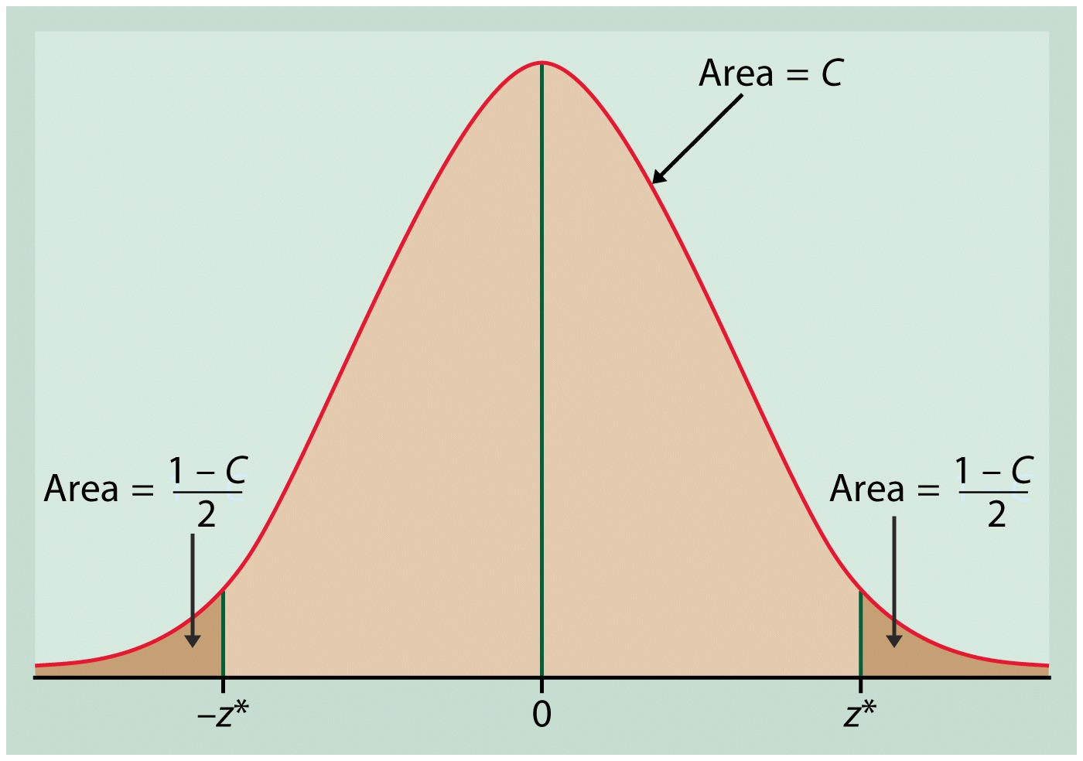
Finding Z*

Slide 21
Z-Multiplier
This means that the upper boundary is at the 97.5 percentile, and the lower boundary is at the 2.5 percentile.
Use your normal table and look up in the middle for .975 (97.5%), go to the edges to observe that the z-value corresponding to this point is 1.96. That is why we have used 1.96 for the 95% CI multiplier.

Slide 22
Other Z-Multipliers
You should be able to verify that the correct multipliers for other confidence levels are: 1.28, 1.64, 2.33, 2.57.
Do you know how these were obtained?

Slide 23
What Does 95% Confidence Mean Anyway?
A 95% CI means that the method used to construct the interval will produce intervals containing the true p in about 95% of the intervals constructed.
This means that if the 95% CI method was used in 100 samples, we should expect that about 95 of the intervals will contain the true p, and about 5 intervals should miss the true p.

Slide 24
Diagram of Confidence
95% of intervals
Contain true p, but
Some do not. About
5% miss truth.
p

Slide 25
CI Meaning
We never know if our CI has contained the true p or not, but we know the method we used has the property that it catches the truth 90% of the time (for a 90% CI), so it probably has done well in our study, or at least is not far from the truth.

Slide 26
Butterfly Net
A confidence interval is like a butterfly net for catching the true p within its boundaries.
Take a swing at the butterfly (p) with your net (CI), you have a known reliability of catching the butterfly (p), say 90%, but you will never know if your net caught the butterfly or not, just that it is typically a good method for catching butterflies, and so it was probably good for you too!

Slide 27
Percent Confidence
The percent confidence refers to the reliability of the CI method to produce intervals that contain the true p.
Why not do a 100% confidence interval? Then we would be completely sure that the interval has contained the true p.

Slide 28
100 % CI for p
A 100% CI for p is (0, 1), this interval is sure to contain the true p.
However this is not very useful. This illustrates the trade-off between %confidence and the usefulness of the interval to simplify the world.
We usually choose 90, 95, or 99 percent confidence levels.

Slide 29
CI Cautions !
Don’t suggest that the parameter varies: There is a 95% chance the true proportion is between .37 and .42. YUCK!! It sounds like the true proportion is wandering around like an intoxicated (blank) fan. (Fill in your most hated sports team in the blank). The true p is fixed, not random.
Don’t claim that other samples will agree with yours: 95% of samples will have proportions supporting proposal X between .37 and .42. NOPE!! This range is not about sample proportions as this statement implies.

Slide 30
CI Cautions ! (Continued)
Don’t be certain about the parameter: The cure rate is between 37 and 42 percent. UGG !! This makes it seem like the true p could never be outside this range. We are not sure of this, just sorta-kinda-sure.
Don’t forget: It’s the parameter (not the statistic): Never, ever say that we are 95% sure the sample proportion is between .37 and .42. DUH ! There is NO uncertainty in this, it HAS to be true.
Don’t claim to know too much.
Do take responsibility (for the uncertainty).

Slide 31
CI Cautions ! (Continued)
Don’t claim to know too much: “I’m 95% confident that between 37 and 42 percent of people in the universe are lunkheads.” Well your population really wasn’t the whole universe, just Podunk State U.
Do take responsibility (for the uncertainty): You are the one who is uncertain, not the parameter p. You must accept that only 95% of CI’s will contain the true value of p.

Slide 32
Usefulness of CI’s
There is a trade-off between reliability (confidence) and the width of the interval.
Increasing confidence means the interval width becomes greater (wider). By increasing the sample size, n, the interval becomes narrower.
How big should the sample size be to get useful, precise information about the population p?

Slide 33
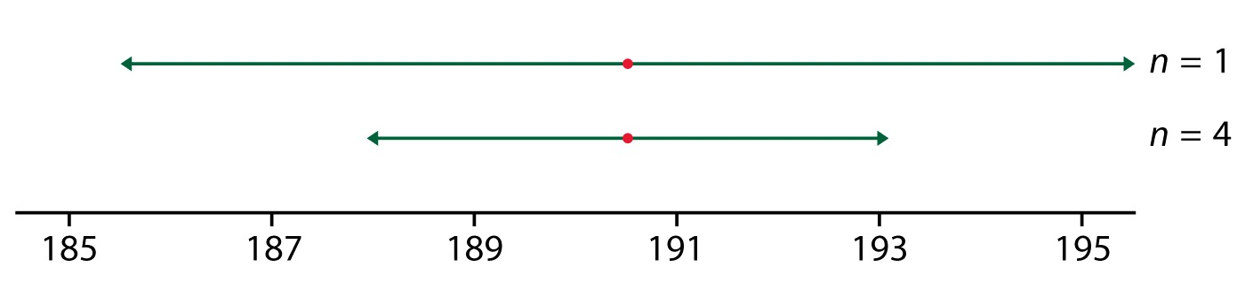
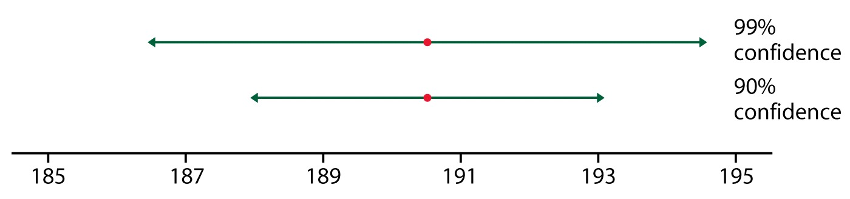
CI Behavior

Slide 34
Margin of Error
The margin of error (m) of a confidence interval is the plus and minus part of the confidence interval, m=Z se(p-hat)
P-hat +/- Z se(p-hat)
P-hat +/- m
A confidence interval that has a margin of error of plus or minus 3 percentage points means that the margin of error m=.03.

Slide 35
Margin of Error
From the formula m=Z se (p-hat), you can see that the margin of error depends on the confidence level (Z multiplier) and through the sample size n inside the expression for se(p-hat).
A common problem in statistics is to figure out what sample size will be needed to obtain the desired accuracy (margin of error m).

Slide 36
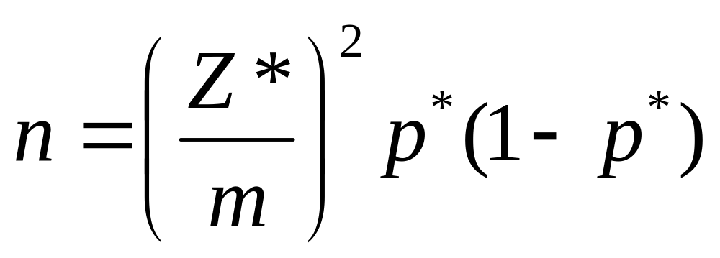
Sample Size Formula
The sample size n needed to get desired margin of error m is given by,

Slide 37
Sample Size
The margin of error desired m, is usually provided in the problem. The value Z* is determined by the level of confidence that is desired. If no level is given, just assume 95% confidence.
The p* value is a bit of a chicken and egg problem. P* is your best guess about the value of the true p.

Slide 38
Sample Size
Mmmm, let’s see, we are trying to do a study to estimate p, but we need to know p (p*) to compute the needed sample size. This seems impossible!
Quit whining and do the best you can. Give the best or most current state of knowledge about p as p*. Usually there is some information about what p might be. If you know absolutely nothing, then use p*=.5.

Slide 39
Why use p*=.5?
Here is a graph of p*(1-p*) for values of p*:
p*(1-p*)
.25
p*=0
.5
p*
1

Slide 40
Why use p*=.5
The graph shows that p*(1-p*) will be largest when p*=.5. This means the sample size will be largest when p*=.5. This means that the sample size will be at least as big as actually needed.
This is called being conservative because you are using more data than would actually be needed to achieve the margin of error desired.

Slide 41
Sample Size Example
NBA Games: I had a basketball viewing orgy at my house. I watched n=30 NBA games from my big blue chair, drank beverages of God, ate lots of popcorn. I found that X=18 games were won by the home team. This means p-hat = 18/30 = .6.
What is a 95% CI for true home court win proportion p?

Slide 42
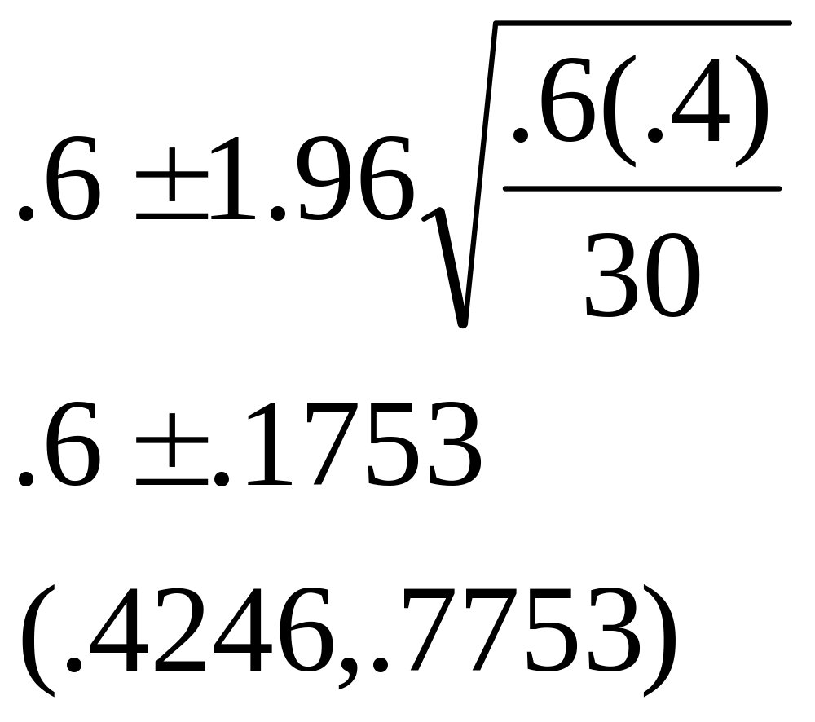
NBA Games Example

Slide 43
NBA Games Example
Plausible range of values for true home court winning proportion was (.42, .78). This is not very helpful, I knew this even before the first popcorn kernel popped.
Why was the procedure not more helpful?
Problem was the margin of error. It was huge ! It was about m=.17, .18. The sample size was too small to make our inference more precise. We need a bigger sample size. How big?

Slide 44
NBA Sample Size
Suppose we wish to obtain a margin of error of m=.02 in a 95% CI for p. What sample size is needed?
n=(1.96/.02)^2 .6(1-.6) = 2304.96
Round up to n=2305 games. Oh Joy! What a fiesta !
Note that our best knowledge was the small study done at my house, there p-hat =.6 so it is our best knowledge of the true p, so p*=.6.

Slide 45
Vietnam Vets Example
If you go back a few slides you will find that in the Vietnam Vets divorce rate example, the margin of error was about .02. Notice this is a small value for m, and it was obtained because the sample size was huge for that problem. Sample size was over 2000 subjects!

Slide 46
Relationship between m and n
m
n

Slide 47
Graph Computation
When p*=.5, m=.05, n=385
When m=.03, n=1068
When m=.02, n=2401
etc

Slide 48
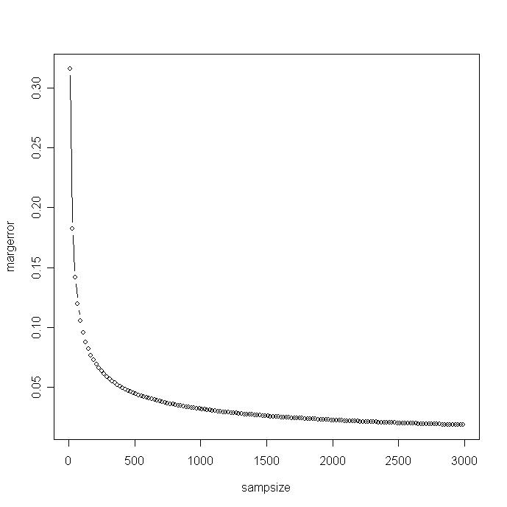

Slide 49
Relationship between m and n
Notice that as the sample size increases initially, there is a big drop in the margin of error. It drops substantially early on.
However, for larger sample sizes there is almost no additional reduction in margin of error for increasing the sample size.
Most big surveys are below 2000 – 3000 subjects. Do you see why?

Slide 50
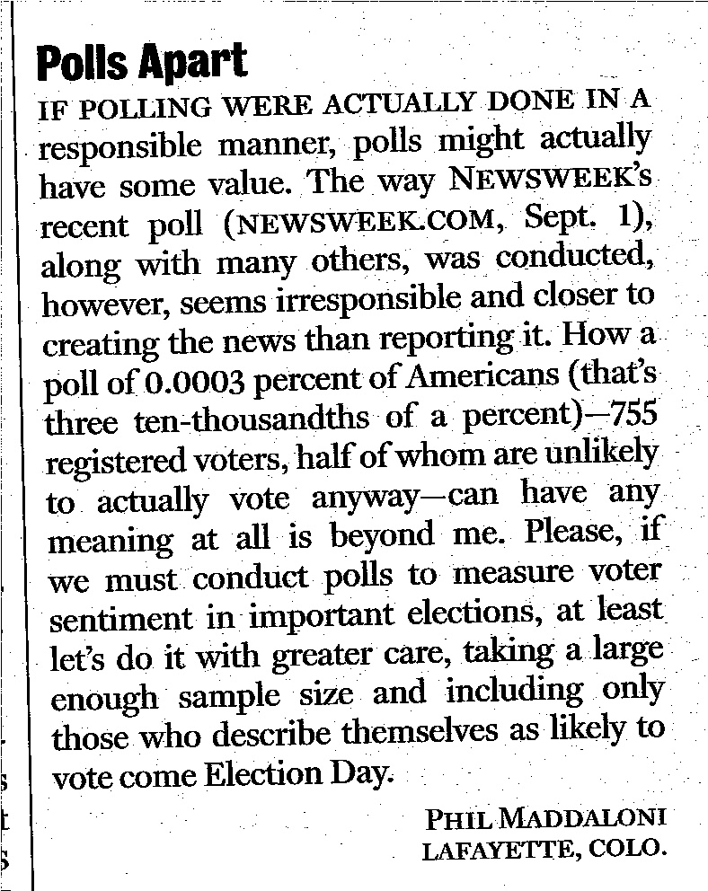
Poor, Ignorant Phil !

Slide 51
Right Eye Dominance
Hold a piece of paper with small hole in middle out in front of you with both hands. Focus on an object across the room to be visible in the hole with both eyes open.
Now shut one eye, if the object is still visible, the open eye is the dominant eye.
Do a 95% CI for the proportion of the population that is right eye dominant, p.

Slide 52
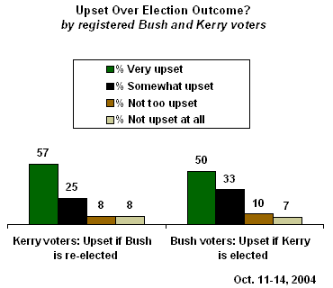
A Recent Poll (Gallup)

Slide 53
Poll Details
Certainly, one of the challenges for the winner of this year's election will be to bring a divided nation together again.
Survey Methods
These results are based on telephone interviews with a randomly selected national sample of 1,013 adults, aged 18 and older, conducted Oct. 14-16. For results based on this sample, one can say with 95% confidence that the maximum error attributable to sampling and other random effects is ±3 percentage points. In addition to sampling error, question wording and practical difficulties in conducting surveys can introduce error or bias into the findings of public opinion polls.

